Slide 1
Chapter 7
Memory Management
Operating Systems:
Internals and Design Principles
Seventh Edition
William Stallings
Notes:
“Operating Systems: Internal and Design Principles”, 7/e, by William Stallings, Chapter 7 “Memory Management”.

Slide 2

Operating Systems:
Internals and Design Principles
I cannot guarantee that I carry all the facts in my mind. Intense mental concentration has a curious way of blotting out what has passed. Each of my cases displaces the last, and Mlle. Carère has blurred my
recollection of Baskerville Hall. Tomorrow some other little problem may be submitted to my notice which will in turn dispossess the fair French lady and the infamous Upwood.
— THE HOUND OF THE BASKERVILLES,
Arthur Conan Doyle
Notes:
In a uniprogramming system, main memory is divided into two parts: one part for the operating system (resident monitor, kernel) and one part for the program currently being executed. In a multiprogramming system, the “user” part of memory must be further subdivided to accommodate multiple processes. The task of subdivision is carried out dynamically by the operating system and is known as memory management .
Effective memory management is vital in a multiprogramming system. If only a few processes are in memory, then for much of the time all of the processes will be waiting for I/O and the processor will be idle. Thus memory needs to be allocated to ensure a reasonable supply of ready processes to consume available processor time.
We begin this chapter with a look at the requirements that memory management is intended to satisfy. Next, we approach the technology of memory management by looking at a variety of simple schemes that have been used. Our focus is the requirement that a program must be loaded into main memory to be executed. This discussion introduces some of the fundamental principles of memory management.

Slide 3
Definition
Memory management is the process of
  allocating primary memory to user programs
  reclaiming that memory when it is no longer needed
  protecting each user’s memory area from other user programs; i.e., ensuring that each program only references memory locations that have been allocated to it.

Slide 4
Requirements
In order to manage memory effectively the OS must have
  Memory allocation policies
  Methods to track the status of memory locations (free or allocated)
  Policies for preempting memory from one process to allocate to another

Slide 5

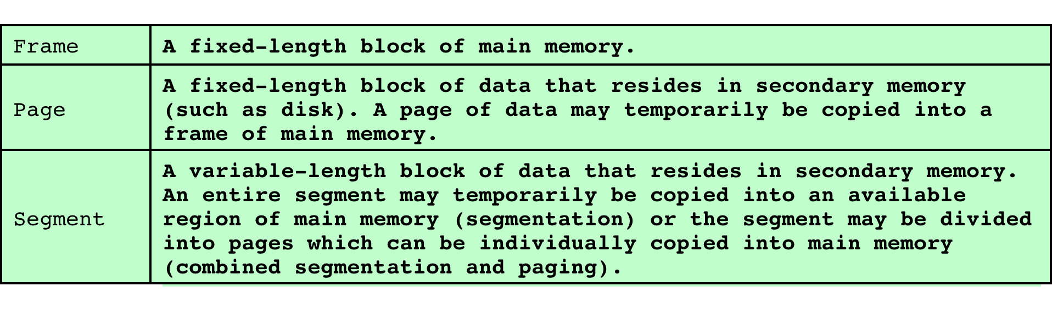
Memory Management
Terms
Notes:
Table 7.1 introduces some key terms for our discussion.

Slide 6
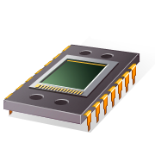
Memory Management Requirements
Memory management is intended to satisfy the following requirements:
  Relocation
  Protection
  Sharing
  Logical organization
  Physical organization
Notes:
While surveying the various mechanisms and policies associated with memory management, it is helpful to keep in mind the requirements that memory management is intended to satisfy. These requirements include the following:
• Relocation
• Protection
• Sharing
• Logical organization
• Physical organization

Slide 7

Relocation
Relocation is the process of adjusting program addresses to match the actual physical addresses where the program resides when it executes
Why is relocation needed?
  Programmer/translator don’t know which other
  programs will be memory resident when
  the program executes
Notes:
In a multiprogramming system, the available main memory is generally shared among a number of processes. Typically, it is not possible for the programmer to know in advance which other programs will be resident in main memory at the time of execution of his or her program. In addition, we would like to be able to swap active processes in and out of main memory to maximize processor utilization by providing a large pool of ready processes to execute. Once a program is swapped out to disk, it would be quite limiting to specify that when it is next swapped back in, it must be placed in the same main memory region as before. Instead, we may need to relocate the process to a different area of memory.

Slide 8
Relocation
Why is relocation needed? (continued)
  Active processes need to be able to be swapped in and out of main memory in order to maximize processor utilization
  Specifying that a process must be placed in the same memory region when it is swapped back
  in would be limiting
Consequently it must be possible to
adjust addresses whenever a program
is loaded.
Notes:
In a multiprogramming system, the available main memory is generally shared among a number of processes. Typically, it is not possible for the programmer to know in advance which other programs will be resident in main memory at the time of execution of his or her program. In addition, we would like to be able to swap active processes in and out of main memory to maximize processor utilization by providing a large pool of ready processes to execute. Once a program is swapped out to disk, it would be quite limiting to specify that when it is next swapped back in, it must be placed in the same main memory region as before. Instead, we may need to relocate the process to a different area of memory.

Slide 9
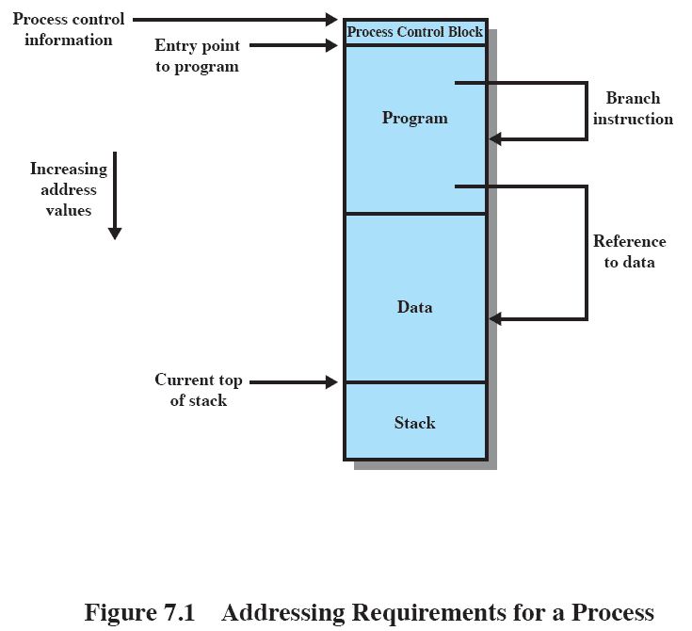
Addressing Requirements
Simplified Process Image
Notes:
Thus, we cannot know ahead of time where a program will be placed, and we must allow for the possibility that the program may be moved about in main memory due to swapping. These facts raise some technical concerns related to addressing, as illustrated in Figure 7.1 . The figure depicts a process image. For simplicity, let us assume that the process image occupies a contiguous region of main memory. Clearly, the operating system will need to know the location of process control information and of the execution stack, as well as the entry point to begin execution of the program for this process. Because the operating system is managing memory and is responsible for bringing this process into main memory, these addresses are easy to come by. In addition, however, the processor must deal with memory references within the program. Branch instructions contain an address to reference
the instruction to be executed next. Data reference instructions contain the address of the byte or word of data referenced. Somehow, the processor hardware and operating system software must be able to translate the memory references found in the code of the program into actual physical memory addresses, reflecting the current location of the program in main memory.

Slide 10

Protection
Processes need to acquire permission to reference memory locations for reading or writing purposes
Location of a program in main memory is unpredictable
Memory references generated by a process must be checked at run time
Mechanisms that support relocation also support protection
Notes:
Each process should be protected against unwanted interference by other processes, whether accidental or intentional. Thus, programs in other processes should not be able to reference memory locations in a process for reading or writing purposes without permission. In one sense, satisfaction of the relocation requirement increases the difficulty of satisfying the protection requirement. Because the location of a program in main memory is unpredictable, it is impossible to check absolute addresses at compile time to assure protection. Furthermore, most programming languages allow the dynamic calculation of addresses at run time (e.g., by computing an array subscript or a pointer into a data structure). Hence all
memory references generated by a process must be checked at run time to ensure that they refer only to the memory space allocated to that process. Fortunately, we shall see that mechanisms that support relocation also support the protection requirement.
Normally, a user process cannot access any portion of the operating system, neither program nor data. Again, usually a program in one process cannot branch to an instruction in another process. Without special arrangement, a program in one process cannot access the data area of another process. The processor must be able to abort such instructions at the point of execution.
Note that the memory protection requirement must be satisfied by the processor (hardware) rather than the operating system (software). This is because the OS cannot anticipate all of the memory references that a program will make. Even if such anticipation were possible, it would be prohibitively time consuming to screen each program in advance for possible memory-reference violations. Thus, it is only possible to assess the permissibility of a memory reference (data access or branch) at the time of execution of the instruction making the reference. To accomplish this, the processor hardware must have that capability.

Slide 11

Sharing
Advantageous to allow each process access to the same copy of the program rather than have their own separate copy
Memory management must allow controlled access to shared areas of memory without compromising protection
Mechanisms used to support relocation support sharing capabilities
Notes:
Any protection mechanism must have the flexibility to allow several processes to access the same portion of main memory. For example, if a number of processes are executing the same program, it is advantageous to allow each process to access the same copy of the program rather than have its own separate copy. Processes that are cooperating on some task may need to share access to the same data structure. The memory management system must therefore allow controlled access to shared areas of memory without compromising essential protection. Again, we will see that the mechanisms used to support relocation support sharing capabilities.

Slide 12

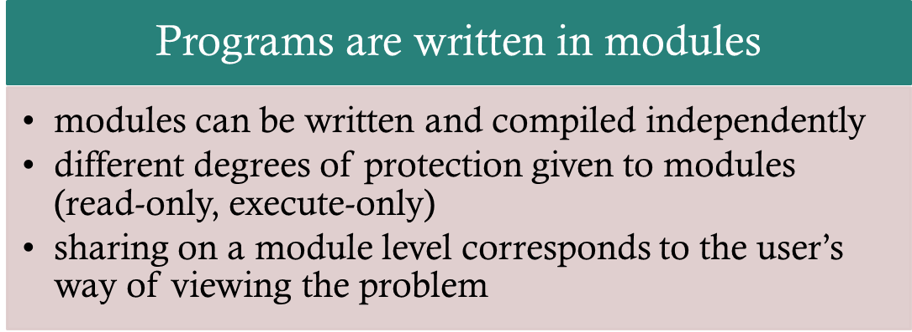
Main memory is organized as a linear (1-D) address space consisting of a sequence of bytes or words.
Programs aren’t necessarily organized this way
Paging versus segmentation
Notes:
Almost invariably, main memory in a computer system is organized as a linear, or one-dimensional, address space, consisting of a sequence of bytes or words. Secondary memory, at its physical level, is similarly organized. While this organization closely mirrors the actual machine hardware, it does not correspond to the way in which programs are typically constructed. Most programs are organized into modules, some of which are unmodifiable (read only, execute only) and some of which contain data that may be modified. If the operating system and computer hardware can effectively deal with user programs and data in the form of modules of some sort, then a number of advantages can be realized:
1. Modules can be written and compiled independently, with all references from
one module to another resolved by the system at run time.
2. With modest additional overhead, different degrees of protection (read only,
execute only) can be given to different modules.
3. It is possible to introduce mechanisms by which modules can be shared among
processes. The advantage of providing sharing on a module level is that this corresponds to the user’s way of viewing the problem, and hence it is easy for
the user to specify the sharing that is desired. The tool that most readily satisfies these requirements is segmentation, which is one of the memory management techniques explored in this chapter.

Slide 13
Physical Organization
Two-level memory for program storage:
  Disk (slow and cheap) & RAM (fast and more expensive)
  Main memory is volatile, disk isn’t
User should not have to be responsible for organizing movement of code/data between the two levels.

Slide 14
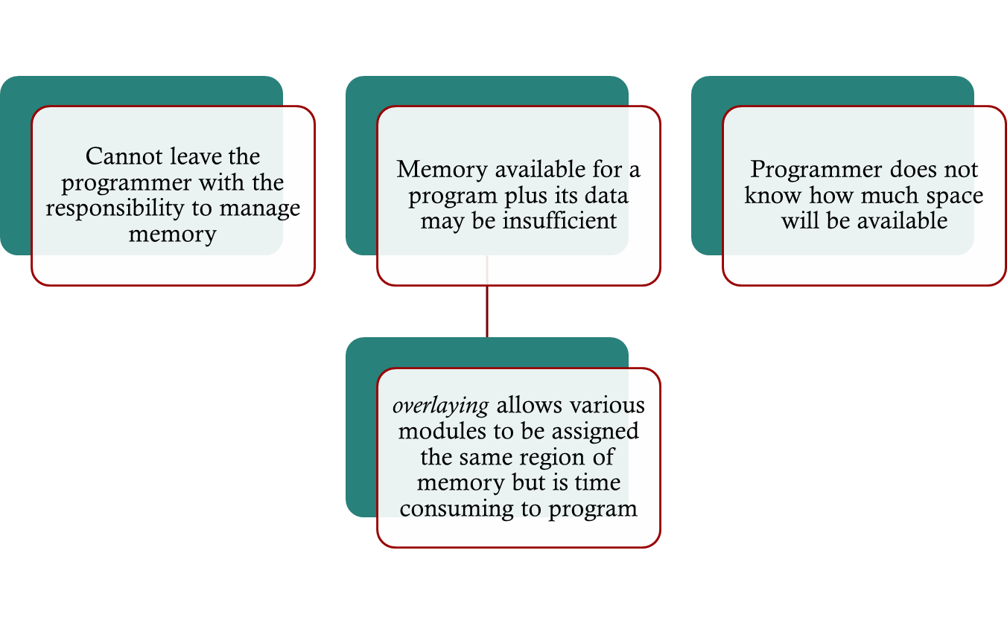
Physical Organization
Notes:
As we discussed in Section 1.5 , computer memory is organized into at least two levels, referred to as main memory and secondary memory. Main memory provides fast access at relatively high cost. In addition, main memory is volatile; that is, it does not provide permanent storage. Secondary memory is slower and cheaper than
main memory and is usually not volatile. Thus secondary memory of large capacity can be provided for long-term storage of programs and data, while a smaller main memory holds programs and data currently in use. In this two-level scheme, the organization of the flow of information between main and secondary memory is a major system concern. The responsibility for this flow could be assigned to the individual programmer, but this is impractical and undesirable for two reasons:
1. The main memory available for a program plus its data may be insufficient. In
that case, the programmer must engage in a practice known as overlaying , in which the program and data are organized in such a way that various modules can be assigned the same region of memory, with a main program responsible for switching the modules in and out as needed. Even with the aid of compiler tools, overlay programming wastes programmer time.
2. In a multiprogramming environment, the programmer does not know at the time of coding how much space will be available or where that space will be. It is clear, then, that the task of moving information between the two levels of memory should be a system responsibility. This task is the essence of memory management.

Slide 15
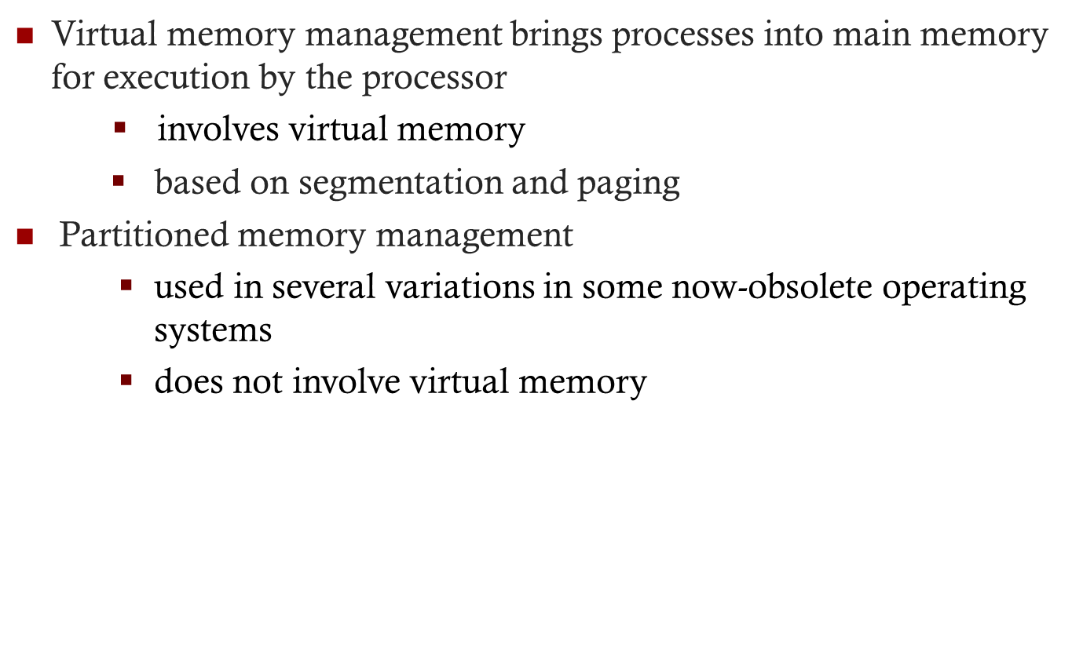
Memory Partitioning
Notes:
The principal operation of memory management is to bring processes into main memory for execution by the processor. In almost all modern multiprogramming systems, this involves a sophisticated scheme known as virtual memory. Virtual memory is, in turn, based on the use of one or both of two basic techniques: segmentation and paging. Before we can look at these virtual memory techniques, we must prepare the ground by looking at simpler techniques that do not involve virtual memory ( Table 7.2 summarizes all the techniques examined in this chapter and the next). One of these techniques, partitioning, has been used in several variations in some now-obsolete operating systems. The other two techniques, simple paging and simple segmentation, are not used by themselves. However, it will clarify the discussion of virtual memory if we look first at these two techniques in the absence of virtual memory considerations.

Slide 16
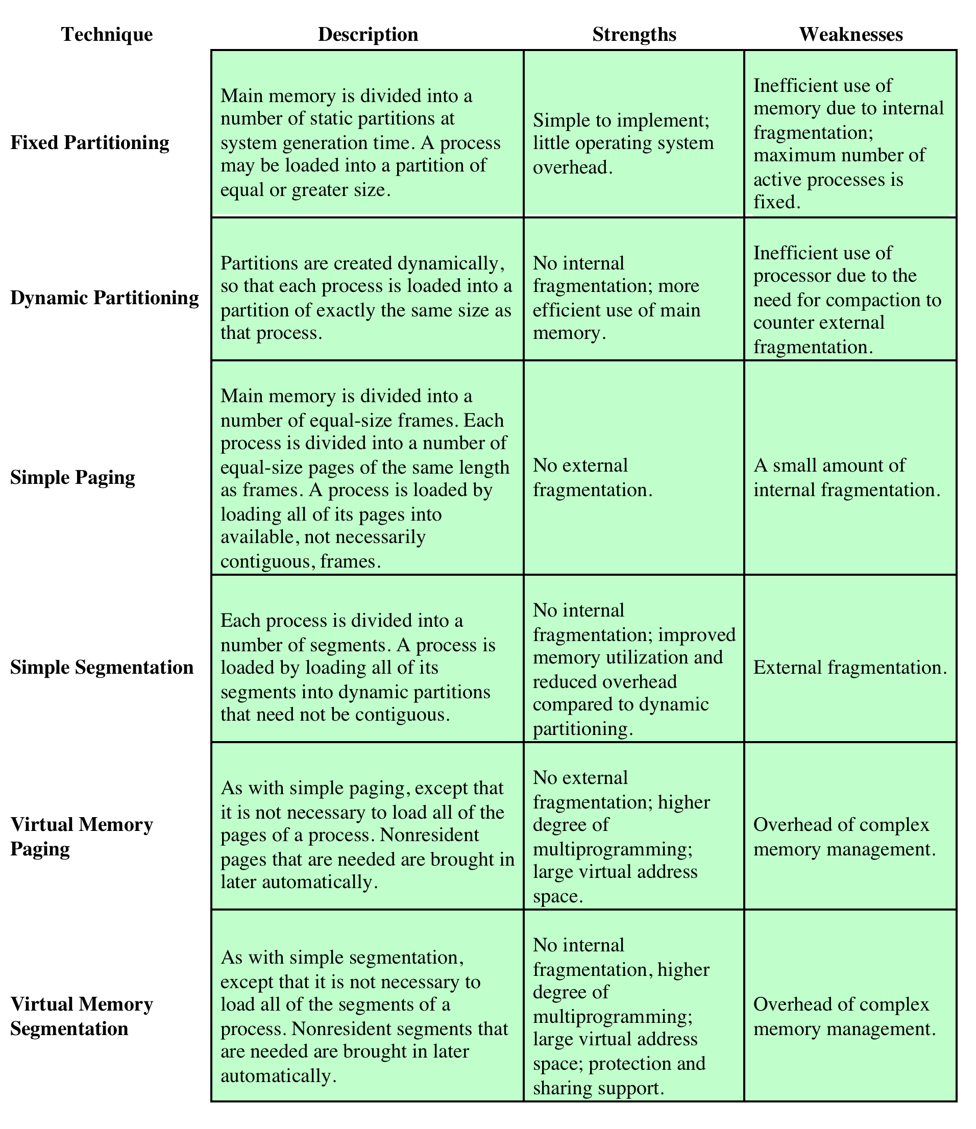
Table 7.2
Memory Management
Techniques
Notes:
Table 7.2 Memory Management Techniques

Slide 17
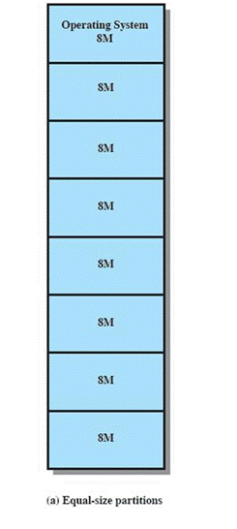
Fixed Partitioning
Equal-size partitions
  any process whose size is less than or equal to the partition size can be loaded into an available partition
The operating system can swap out a process if all partitions are full and no process is in the Ready or Running state
Notes:
In most schemes for memory management, we can assume that the OS occupies some fixed portion of main memory and that the rest of main memory is available for use by multiple processes. The simplest scheme for managing this available memory is to partition it into regions with fixed boundaries.
PARTITION SIZES Figure 7.2 shows examples of two alternatives for fixed partitioning. One possibility is to make use of equal-size partitions. In this case, any process whose size is less than or equal to the partition size can be loaded into any available partition. If all partitions are full and no process is in the Ready or Running state, the operating system can swap a process out of any of the partitions and load in another process, so that there is some work for the processor.

Slide 18


A program may be too big to fit in a partition
    program needs to be designed with the use of overlays
Main memory utilization is inefficient
    any program, regardless of size, occupies an entire partition
    internal fragmentation
      wasted space due to the block of data loaded being smaller than the partition
Notes:
There are two difficulties with the use of equal-size fixed partitions:
• A program may be too big to fit into a partition. In this case, the programmer must design the program with the use of overlays so that only a portion of the program need be in main memory at any one time. When a module is needed that is not present, the user’s program must load that module into the program’s partition, overlaying whatever programs or data are there.
• Main memory utilization is extremely inefficient. Any program, no matter how small, occupies an entire partition. In our example, there may be a program whose length is less than 2 Mbytes; yet it occupies an 8-Mbyte partition whenever it is swapped in. This phenomenon, in which there is wasted space internal to a partition due to the fact that the block of data loaded is smaller than the partition, is referred to as internal fragmentation .

Slide 19

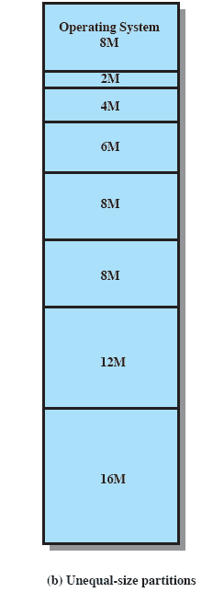
Using unequal size partitions helps lessen the problems
  programs up to 16M can be accommodated without overlays
  partitions smaller than 8M allow smaller programs to be accommodated with less internal fragmentation
Notes:
Both of these problems can be lessened, though not solved, by using unequal size partitions ( Figure 7.2b ). In this example, programs as large as 16 Mbytes can be accommodated without overlays. Partitions smaller than 8 Mbytes allow smaller programs to be accommodated with less internal fragmentation.

Slide 20
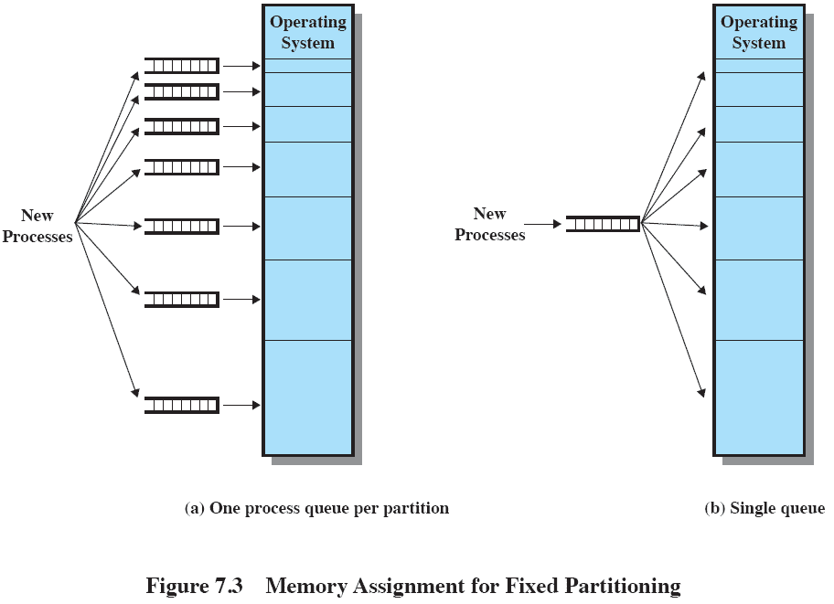

Memory Assignment
Notes:
PLACEMENT ALGORITHM With equal-size partitions, the placement of processes in memory is trivial. As long as there is any available partition, a process can be loaded into that partition. Because all partitions are of equal size, it does not matter which partition is used. If all partitions are occupied with processes that are not ready to run, then one of these processes must be swapped out to make room for a new process. Which one to swap out is a scheduling decision; this topic is explored in Part Four.
With unequal-size partitions, there are two possible ways to assign processes to partitions. The simplest way is to assign each process to the smallest partition within which it will fit. 1 In this case, a scheduling queue is needed for each partition, to hold swapped-out processes destined for that partition ( Figure 7.3a ). The advantage of this approach is that processes are always assigned in such a way as to minimize wasted memory within a partition (internal fragmentation).
Although this technique seems optimum from the point of view of an individual partition, it is not optimum from the point of view of the system as a whole. In Figure 7.2b , for example, consider a case in which there are no processes with a size between 12 and 16M at a certain point in time. In that case, the 16M partition will remain unused, even though some smaller process could have been assigned to it. Thus, a preferable approach would be to employ a single queue for all processes ( Figure 7.3b ). When it is time to load a process into main memory, the smallest available partition that will hold the process is selected. If all partitions are occupied, then a swapping decision must be made. Preference might be given to swapping out of the smallest partition that will hold the incoming process. It is also possible to consider other factors, such as priority, and a preference for swapping out blocked
processes versus ready processes.

Slide 21


The number of partitions specified at system generation time limits the number of active processes in the system
Small jobs will not utilize partition space efficiently
Notes:
The use of unequal-size partitions provides a degree of flexibility to fixed partitioning. In addition, it can be said that fixed-partitioning schemes are relatively simple and require minimal OS software and processing overhead. However, there are disadvantages:
• The number of partitions specified at system generation time limits the number of active (not suspended) processes in the system.
• Because partition sizes are preset at system generation time, small jobs will not utilize partition space efficiently. In an environment where the main storage requirement of all jobs is known beforehand, this may be reasonable, but in most cases, it is an inefficient technique.

Slide 22


Partitions are of variable length and number
Process is allocated exactly as much memory as it requires
This technique was used by IBM’s mainframe operating system, OS/MVT
Notes:
To overcome some of the difficulties with fixed partitioning, an approach known as dynamic partitioning was developed. Again, this approach has been supplanted by more sophisticated memory management techniques. An important operating system that used this technique was IBM’s mainframe operating system, OS/MVT (Multiprogramming with a Variable Number of Tasks).
With dynamic partitioning, the partitions are of variable length and number. When a process is brought into main memory, it is allocated exactly as much memory as it requires and no more.

Slide 23
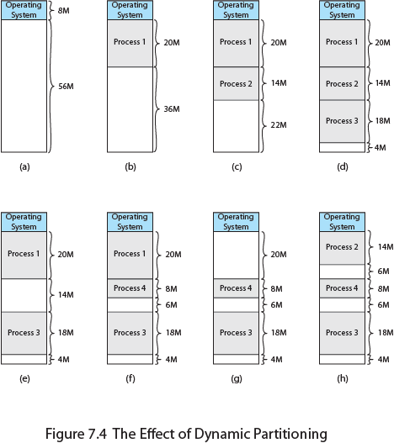
Effect of Dynamic
Partitioning
Notes:
An example, using 64 Mbytes of main memory, is shown in Figure 7.4 . Initially, main memory is empty, except for the OS (a). The first three processes are loaded in, starting where the operating system ends and occupying just enough space for each process (b, c, d). This leaves a “hole” at the end of memory that is too small for a fourth process. At some point, none of
the processes in memory is ready. The operating system swaps out process 2 (e), which leaves sufficient room to load a new process, process 4 (f). Because process 4 is smaller than process 2, another small hole is created. Later, a point is reached at which none of the processes in main memory is ready, but process 2, in the Ready-Suspend state, is available. Because there is insufficient room in memory for process 2, the operating system swaps process 1 out (g) and swaps process 2 back in (h).
As this example shows, this method starts out well, but eventually it leads to a situation in which there are a lot of small holes in memory. As time goes on, memory becomes more and more fragmented, and memory utilization declines. This phenomenon is referred to as external fragmentation , indicating that the memory that is external to all partitions becomes increasingly fragmented. This is in contrast to internal fragmentation, referred to earlier.

Slide 24
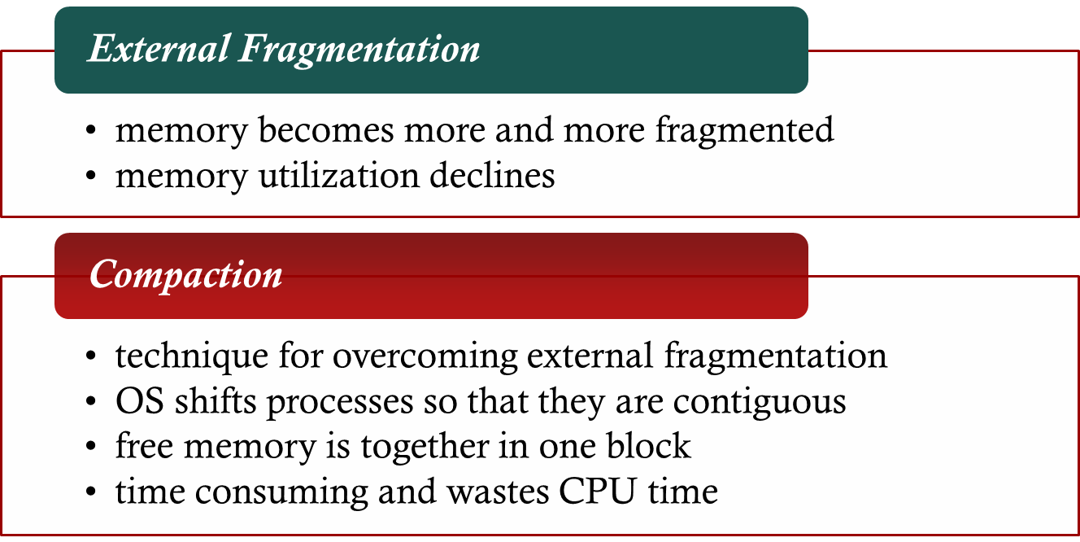
Dynamic Partitioning
Notes:
One technique for overcoming external fragmentation is compaction : From time to time, the OS shifts the processes so that they are contiguous and so that all of the free memory is together in one block. For example, in Figure 7.4h , compaction will result in a block of free memory of length 16M. This may well be sufficient to load in an additional process. The difficulty with compaction is that it is a time-consuming procedure and wasteful of processor time. Note that compaction implies the need for a dynamic relocation capability. That is, it must be possible to move a program from one region to another in main memory without invalidating the memory references in the program (see Appendix 7A).

Slide 25
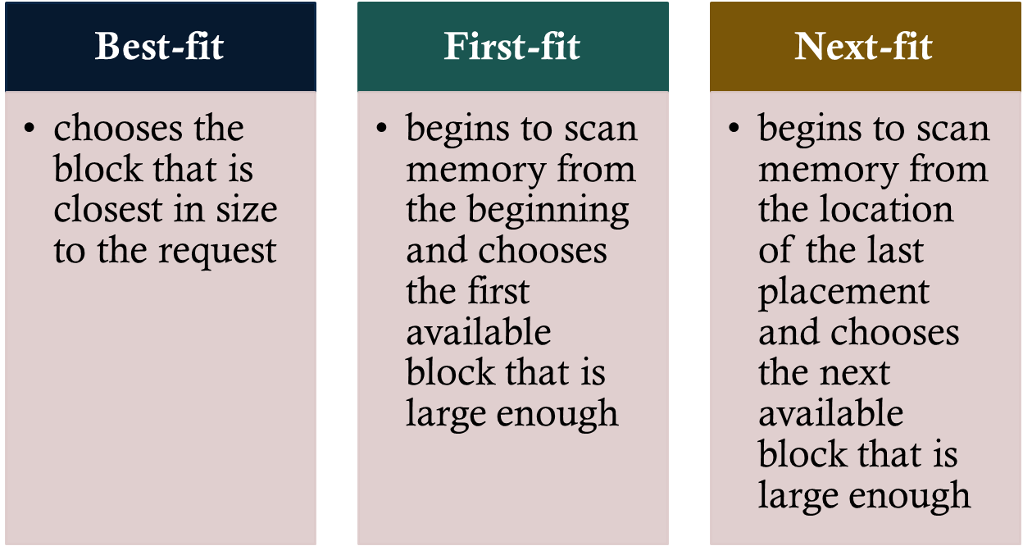
Placement Algorithms
Notes:
PLACEMENT ALGORITHM Because memory compaction is time consuming, the OS designer must be clever in deciding how to assign processes to memory (how to plug the holes). When it is time to load or swap a process into main memory, and if there is more than one free block of memory of sufficient size, then the operating system must decide which free block to allocate.
Three placement algorithms that might be considered are best-fit, first-fit, and next-fit. All, of course, are limited to choosing among free blocks of main memory that are equal to or larger than the process to be brought in. Best-fit chooses the block that is closest in size to the request. First-fit begins to scan memory from the beginning and chooses the first available block that is large enough. Next-fit begins to scan memory from the location of the last placement, and chooses the next available block that is large enough.

Slide 26
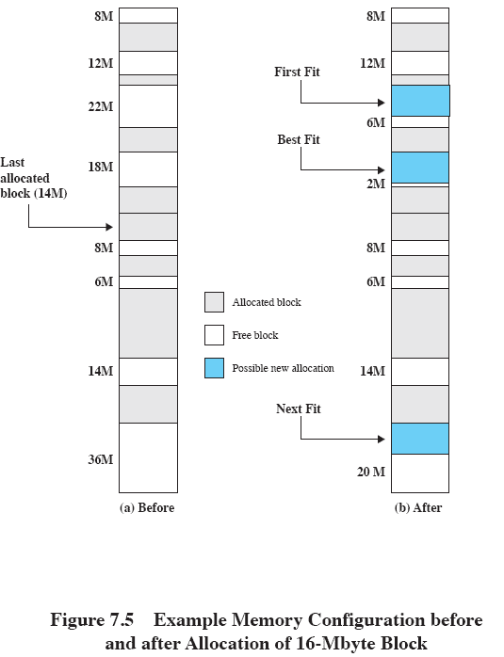
Memory Configuration
Example
Notes:
Figure 7.5a shows an example memory configuration after a number of placement and swapping-out operations. The last block that was used was a 22-Mbyte block from which a 14-Mbyte partition was created. Figure 7.5b shows the difference between the best-, first-, and next-fit placement algorithms in satisfying a 16-Mbyte allocation request. Best-fit will search the entire list of available blocks and make use of the 18-Mbyte block, leaving a 2-Mbyte fragment. First-fit results in a 6-Mbyte fragment, and next-fit results in a 20-Mbyte fragment.
Which of these approaches is best will depend on the exact sequence of process swapping that occurs and the size of those processes. However, some general comments can be made (see also [BREN89], [SHOR75], and [BAYS77]). The first-fit algorithm is not only the simplest but usually the best and fastest as well. The next-fit algorithm tends to produce slightly worse results than the first-fit. The next-fit algorithm will more frequently lead to an allocation from a free block at the end of memory. The result is that the largest block of free memory, which usually appears at the end of the memory space, is quickly broken up into small fragments. Thus, compaction may be required more frequently with next-fit. On the other hand, the first-fit algorithm may litter the front end with small free partitions that need to be searched over on each subsequent first-fit pass. The best-fit algorithm, despite its name, is usually the worst performer. Because this algorithm looks for the smallest block that will satisfy the requirement, it guarantees that the fragment left behind is as small as possible. Although each memory request always wastes the smallest amount of memory, the result is that main memory is quickly littered by blocks too small to satisfy memory allocation requests. Thus, memory compaction must be done more frequently than with the other algorithms.

Slide 27

Buddy System
Comprised of fixed and dynamic partitioning schemes
Space available for allocation is treated as a single block
Memory blocks are available of size 2^{K} words, L ≤ K ≤ U, where
    2^{L} = smallest size block that is allocated
    2^{U} = largest size block that is allocated; generally 2^{U} is the size of the entire memory available for allocation
Notes:
Both fixed and dynamic partitioning schemes have drawbacks. A fixed partitioning scheme limits the number of active processes and may use space inefficiently if there is a poor match between available partition sizes and process sizes. A dynamic partitioning scheme is more complex to maintain and includes the overhead of compaction. An interesting compromise is the buddy system ([KNUT97], [PETE77]).
Memory blocks are available of size 2^{K} words, L ≤ K ≤ U, where
2^{L} = smallest size block that is allocated
2^{U} = largest size block that is allocated; generally 2^{U} is the size of the entire memory available for allocation
To begin, the entire space available for allocation is treated as a single block of size 2^{U} . If a request of size s such that 2^{U} –1 < s 2^{U} is made, then the entire block is allocated. Otherwise, the block is split into two equal buddies of size 2^{U} –1 . If 2^{U} –2 < s 2^{U} –1 , then the request is allocated to one of the two buddies. Otherwise, one of the buddies is split in half again. This process continues until the smallest block greater than or equal to s is generated and allocated to the request. At any time, the buddy system maintains a list of holes (unallocated blocks) of each size 2 i . A hole may be removed from the ( i + 1) list by splitting it in half to create two buddies of size 2 i in the i list. Whenever a pair of buddies on the i list both become unallocated, they are removed from that list and coalesced into a single block on the ( i + 1) list.

Slide 28
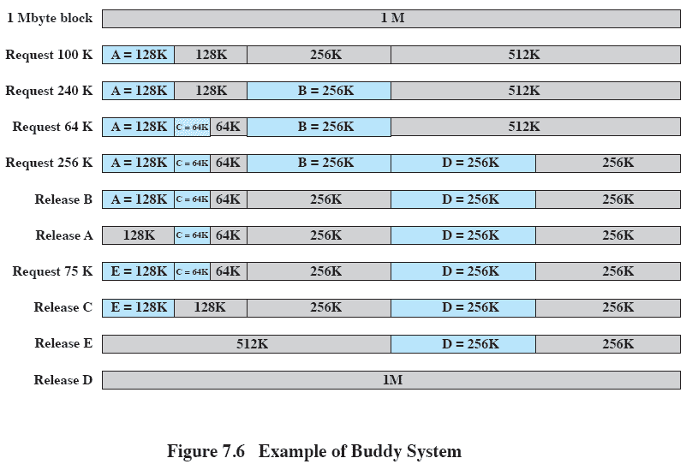
Buddy System Example
Notes:
Figure 7.6 gives an example using a 1-Mbyte initial block. The first request, A, is for 100 Kbytes, for which a 128K block is needed. The initial block is divided into two 512K buddies. The first of these is divided into two 256K buddies, and the first of these is divided into two 128K buddies, one of which is allocated to A. The next request, B, requires a 256K block. Such a block is already available and is allocated. The process continues with splitting and coalescing occurring as needed. Note that when E is released, two 128K buddies are coalesced into a 256K block, which is immediately coalesced with its buddy.

Slide 29

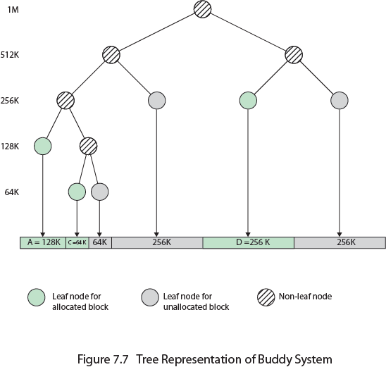
Notes:
Figure 7.7 shows a binary tree representation of the buddy allocation immediately after the Release B request. The leaf nodes represent the current partitioning of the memory. If two buddies are leaf nodes, then at least one must be allocated; otherwise they would be coalesced into a larger block.
The buddy system is a reasonable compromise to overcome the disadvantages of both the fixed and variable partitioning schemes, but in contemporary operating systems, virtual memory based on paging and segmentation is superior. However, the buddy system has found application in parallel systems as an efficient means of allocation and release for parallel programs (e.g., see [JOHN92]). A modified form of the buddy system is used for UNIX kernel memory allocation (described in Chapter 8 ).

Slide 30
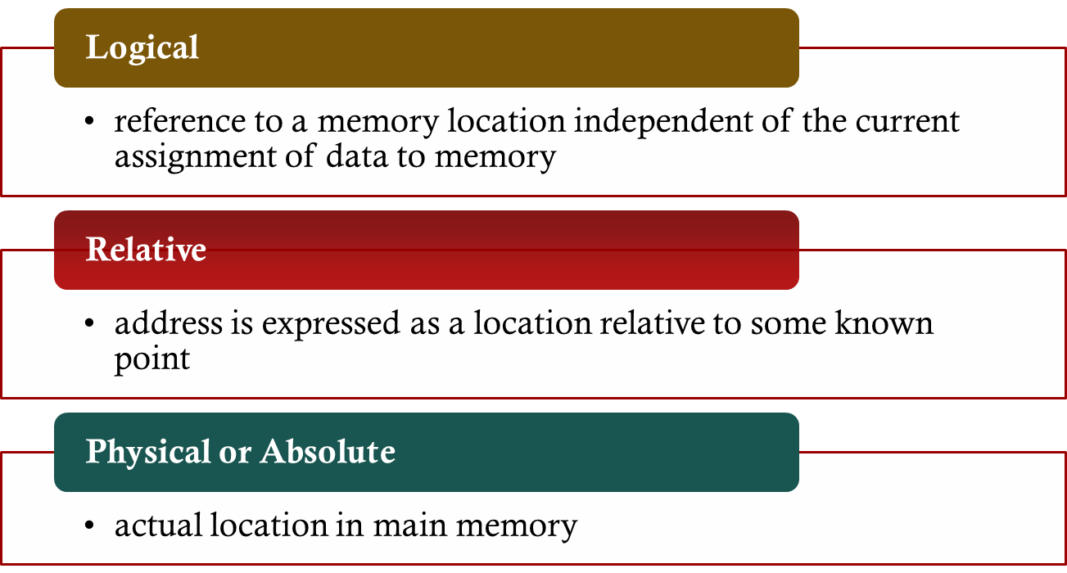
Addresses
Notes:
A logical address is a reference to a memory location independent of the current assignment of data to memory; a translation must be made to a physical address before the memory access can be achieved. A relative address is a particular example of logical address, in which the address is expressed as a location relative to some known point, usually a value in a processor register. A physical address , or absolute address, is an actual location in main memory.

Slide 31
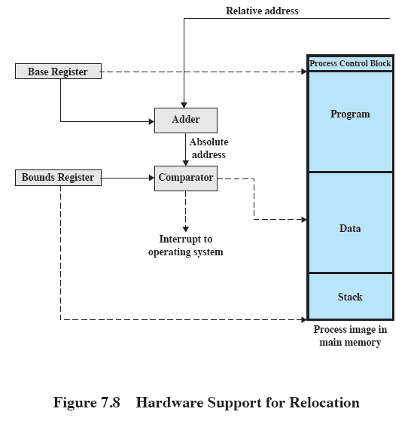

Notes:
Programs that employ relative addresses in memory are loaded using dynamic run-time loading (see Appendix 7A for a discussion). Typically, all of the memory references in the loaded process are relative to the origin of the program. Thus a hardware mechanism is needed for translating relative addresses to physical main memory addresses at the time of execution of the instruction that contains the reference.
Figure 7.8 shows the way in which this address translation is typically accomplished. When a process is assigned to the Running state, a special processor register, sometimes called the base register, is loaded with the starting address in main memory of the program. There is also a “bounds” register that indicates the ending location of the program; these values must be set when the program is loaded into memory or when the process image is swapped in. During the course of execution of the process, relative addresses are encountered. These include the contents of the instruction register, instruction addresses that occur in branch and call instructions, and data addresses that occur in load and store instructions. Each such relative address goes through two steps of manipulation by the processor. First, the value in the base register is added to the relative address to produce an absolute address. Second, the resulting address is compared to the value in the bounds register. If the address is within bounds, then the instruction execution may proceed. Otherwise, an interrupt is generated to the operating system, which must respond to the error in some fashion.
The scheme of Figure 7.8 allows programs to be swapped in and out of memory during the course of execution. It also provides a measure of protection: Each process image is isolated by the contents of the base and bounds registers and safe from unwanted accesses by other processes.

Slide 32


Partition memory into equal fixed-size chunks that are relatively small
Process is also divided into small fixed-size chunks of the same size
Notes:
Both unequal fixed-size and variable-size partitions are inefficient in the use of memory; the former results in internal fragmentation, the latter in external fragmentation. Suppose, however, that main memory is partitioned into equal fixed-size chunks that are relatively small, and that each process is also divided into small fixed-size chunks of the same size. Then the chunks of a process, known as pages , could be assigned to available chunks of memory, known as frames , or page frames. We show in this section that the wasted space in memory for each process is due to internal fragmentation consisting of only a fraction of the last page of a process. There is no external fragmentation.

Slide 33
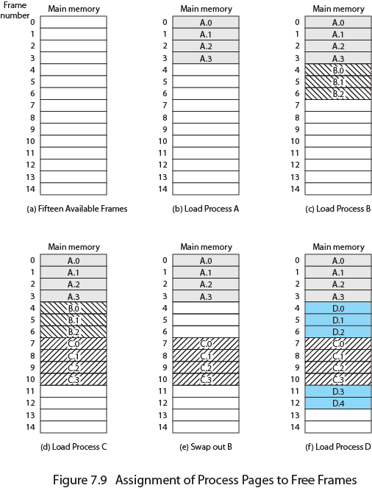
Assignment of Process to Free Frames
Notes:
Figure 7.9 illustrates the use of pages and frames. At a given point in time, some of the frames in memory are in use and some are free. A list of free frames is maintained by the OS. Process A, stored on disk, consists of four pages. When it is time to load this process, the OS finds four free frames and loads the four pages of process A into the four frames ( Figure 7.9b ). Process B, consisting of three pages, and process C, consisting of four pages, are subsequently loaded. Then process B is suspended and is swapped out of main memory. Later, all of the processes in main memory are blocked, and the OS needs to bring in a new process, process D, which consists of five pages.
Now suppose, as in this example, that there are not sufficient unused contiguous frames to hold the process. Does this prevent the operating system from loading D? The answer is no, because we can once again use the concept of logical address.

Slide 34

Page Table
Maintained by operating system for each process
Contains the frame location for each page in the process
Processor must know how to access the page table for the current process
Used by processor to produce a physical address
Notes:
A simple base address register will no longer suffice. Rather, the operating system maintains a page table for each process. The page table shows the frame location for each page of the process. Within the program, each logical address consists of a page number and an offset within the page. Recall that in the case of simple partition, a logical address is the location of a word relative to the beginning of the program; the processor translates that into a physical address. With paging, the logical-to-physical address translation is still done by processor hardware. Now the processor must know how to access the page table of the current process. Presented with a logical address (page number, offset), the processor uses the page table to produce a physical address (frame number, offset).

Slide 35
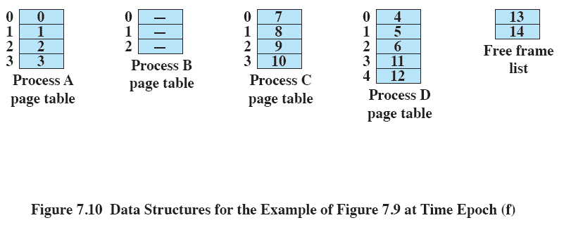
Data Structures
Notes:
Continuing our example, the five pages of process D are loaded into frames 4, 5, 6, 11, and 12. Figure 7.10 shows the various page tables at this time. A page table contains one entry for each page of the process, so that the table is easily indexed by the page number (starting at page 0 ). Each page table entry contains the number of the frame in main memory, if any, that holds the corresponding page. In addition, the OS maintains a single free-frame list of all the frames in main memory that are currently unoccupied and available for pages.
Thus we see that simple paging, as described here, is similar to fixed partitioning. The differences are that, with paging, the partitions are rather small; a program may occupy more than one partition; and these partitions need not be contiguous.

Slide 36
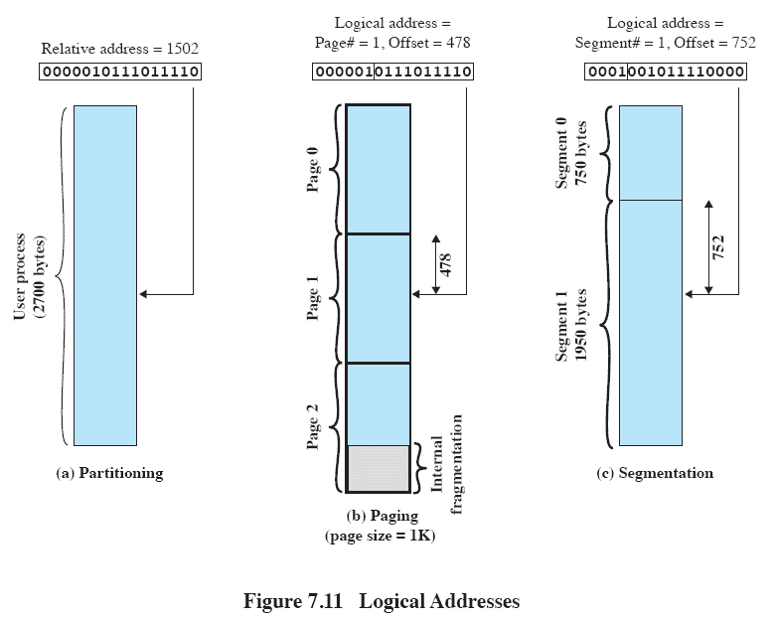
Logical Addresses
Notes:
To make this paging scheme convenient, let us dictate that the page size, hence the frame size, must be a power of 2. With the use of a page size that is a power of 2, it is easy to demonstrate that the relative address, which is defined with reference to the origin of the program, and the logical address, expressed as a page number and offset, are the same. An example is shown in Figure 7.11 . In this example, 16-bit addresses are used, and the page size is 1K 1,024 bytes. The relative address 1502, in binary form, is 0000010111011110. With a page size of 1K, an offset field of 10 bits is needed, leaving 6 bits for the page number. Thus a program can consist of a maximum of 2^6 (64) pages of 1K bytes each. As Figure 7.11b shows, relative address 1502 corresponds to an offset of 478 (0111011110) on page 1 (000001), which yields the same 16-bit number, 0000010111011110.
The consequences of using a page size that is a power of 2 are twofold. First, the logical addressing scheme is transparent to the programmer, the assembler, and the linker. Each logical address (page number, offset) of a program is identical to its relative address. Second, it is a relatively easy matter to implement a function in hardware to perform dynamic address translation at run time. Consider an address of n + m bits, where the leftmost n bits are the page number and the rightmost m bits are the offset. In our example ( Figure 7.11b ), n 6 and m 10. The following steps are needed for address translation:
• Extract the page number as the leftmost n bits of the logical address.
• Use the page number as an index into the process page table to find the frame number, k .
• The starting physical address of the frame is k °— 2 m
and the physical address of the referenced byte is that number plus the offset. This physical address need not be calculated; it is easily constructed by appending the frame number to the offset.

Slide 37

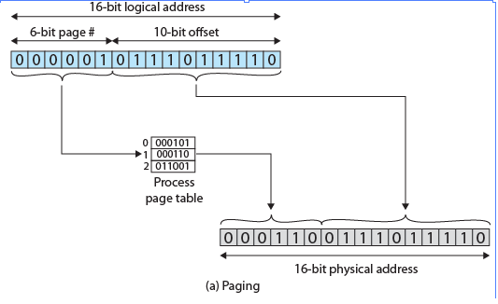
Notes:
In our example, we have the logical address 0000010111011110, which is page number 1, offset 478. Suppose that this page is residing in main memory frame 6 binary 000110. Then the physical address is frame number 6, offset 478 0001100111011110 ( Figure 7.12a ).

Slide 38

Segmentation
A program can be subdivided into segments
    may vary in length
    there is a maximum length
Addressing consists of two parts:
    segment number
    an offset
Similar to dynamic partitioning
Eliminates internal fragmentation
Notes:
A user program can be subdivided using segmentation, in which the program and its associated data are divided into a number of segments . It is not required that all segments
of all programs be of the same length, although there is a maximum segment length. As with paging, a logical address using segmentation consists of two parts, in this case a segment number and an offset.
Because of the use of unequal-size segments, segmentation is similar to dynamic partitioning. In the absence of an overlay scheme or the use of virtual
memory, it would be required that all of a program’s segments be loaded into memory for execution. The difference, compared to dynamic partitioning, is that with
segmentation a program may occupy more than one partition, and these partitions need not be contiguous. Segmentation eliminates internal fragmentation but, like
dynamic partitioning, it suffers from external fragmentation. However, because a process is broken up into a number of smaller pieces, the external fragmentation
should be less.

Slide 39
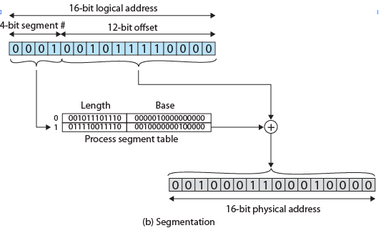
Logical-to-Physical Address
Translation - Segmentation
Notes:
In our example, we have the logical address 0001001011110000, which is segment number 1, offset 752. Suppose that this segment is residing in main memory starting at physical address 0010000000100000. Then the physical address is 0010000000100000 + 001011110000 0010001100010000 ( Figure 7.12b ).

Slide 40

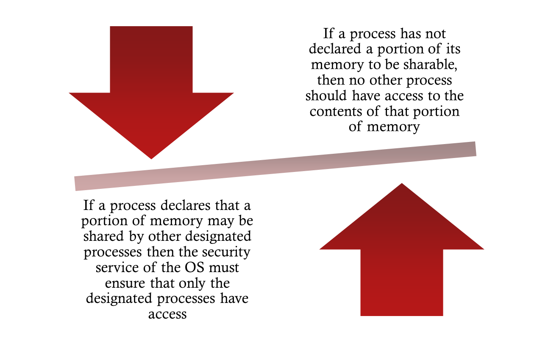


Slide 41

Buffer Overflow Attacks
Security threat related to memory management
Also known as a buffer overrun
Can occur when a process attempts to store data beyond the limits of a fixed-sized buffer
One of the most prevalent and dangerous types of security attacks
Notes:
One serious security threat related to memory management remains to be introduced:
buffer overflow , also known as a buffer overrun , which is defined in the NIST
(National Institute of Standards and Technology) Glossary of Key Information
Security Terms as follows:
buffer overrun: A condition at an interface under which more input can be
placed into a buffer or data-holding area than the capacity allocated, overwriting
other information. Attackers exploit such a condition to crash a system or to
insert specially crafted code that allows them to gain control of the system.
A buffer overflow can occur as a result of a programming error when a process
attempts to store data beyond the limits of a fixed-sized buffer and consequently
overwrites adjacent memory locations. These locations could hold other program
variables or parameters or program control flow data such as return addresses
and pointers to previous stack frames. The buffer could be located on the stack,
in the heap, or in the data section of the process. The consequences of this error
include corruption of data used by the program, unexpected transfer of control in
the program, possibly memory access violations, and very likely eventual program
termination. When done deliberately as part of an attack on a system, the transfer
of control could be to code of the attacker’s choosing, resulting in the ability to
execute arbitrary code with the privileges of the attacked process. Buffer overflow
attacks are one of the most prevalent and dangerous types of security attacks.

Slide 42

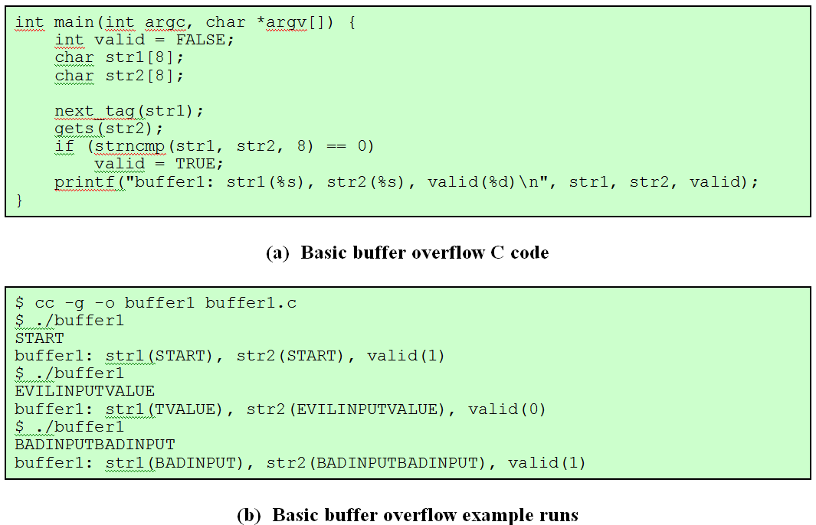
Notes:
To illustrate the basic operation of a common type of buffer overflow,
known as stack overflow , consider the C main function given in Figure 7.13a . This
contains three variables ( valid , str1 , and str2 ), 2 whose values will typically
be saved in adjacent memory locations. Their order and location depends on the
type of variable (local or global), the language and compiler used, and the target
machine architecture.

Slide 43

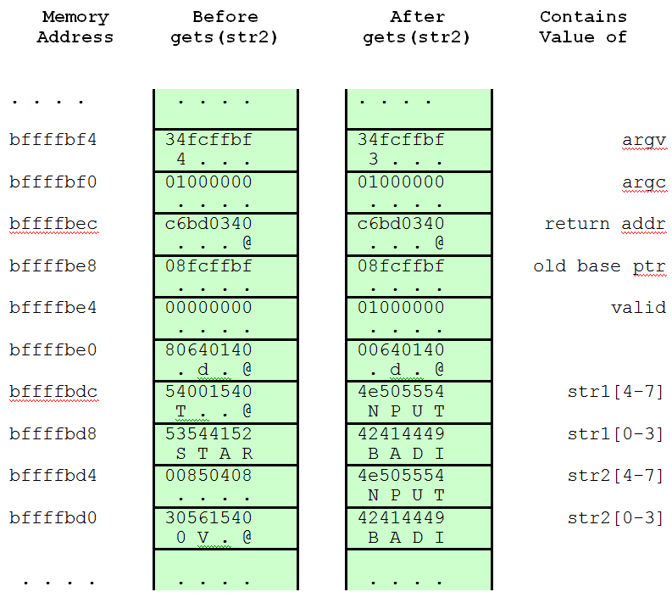
Notes:
Figure 7.14 Basic Buffer Overflow Stack Values

Slide 44

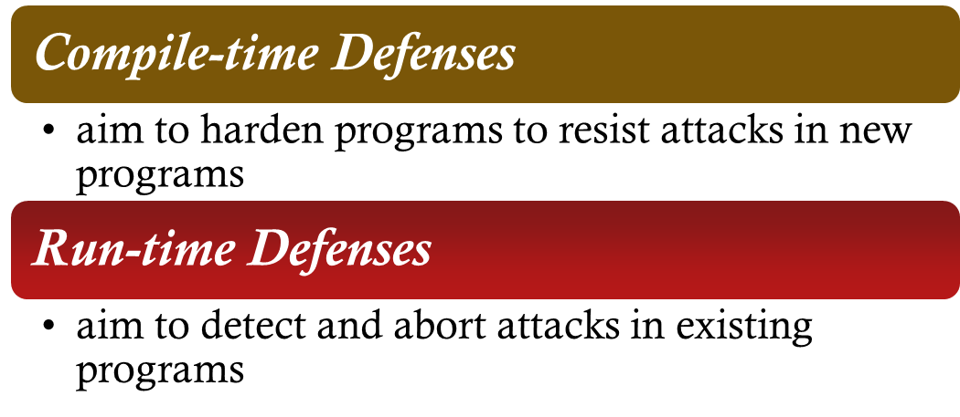
Defending Against
Buffer Overflows
Prevention
Detecting and aborting
Countermeasure categories:
Notes:
Finding and exploiting a stack buffer overflow is not that difficult. The large number
of exploits over the previous couple of decades clearly illustrates this. There
is consequently a need to defend systems against such attacks by either preventing
them or at least detecting and aborting such attacks. Countermeasures can be
broadly classified into two categories:
• Compile-time defenses, which aim to harden programs to resist attacks in new
programs
• Run-time defenses, which aim to detect and abort attacks in existing programs
While suitable defenses have been known for a couple of decades, the very
large existing base of vulnerable software and systems hinders their deployment.
Hence the interest in run-time defenses, which can be deployed in operating
systems and updates and can provide some protection for existing vulnerable
programs.

Slide 45
Summary
Memory Management
    one of the most important and complex tasks of an operating system
    needs to be treated as a resource to be allocated to and shared among a number of active processes
    desirable to maintain as many processes in main memory as possible
    desirable to free programmers from size restriction in program development
    basic tools are paging and segmentation (possible to combine)
        paging – small fixed-sized pages
        segmentation – pieces of varying size
Notes:
Chapter 7 Summary
One of the most important and complex tasks of an operating system is memory
management. Memory management involves treating main memory as a resource
to be allocated to and shared among a number of active processes. To use the processor
and the I/O facilities efficiently, it is desirable to maintain as many processes
in main memory as possible. In addition, it is desirable to free programmers from
size restrictions in program development.
The basic tools of memory management are paging and segmentation. With
paging, each process is divided into relatively small, fixed-size pages. Segmentation
provides for the use of pieces of varying size. It is also possible to combine segmentation
and paging in a single memory management scheme.

